Slide 1
5S Methodology

Slide 2
What is 5S?
A process to achieve and sustain an organized, productive and safe virtual and physical workspace
5S engages people through the use of ‘Standards’ and ‘Discipline’.
It is not just about housekeeping but concentrating on maintaining the standards and discipline to manage the organization - all achieved by upholding and showing respect for the workplace every day.

Slide 3
5s APPLIED EVERYWHERE
Physical Examples | Virtual / Digital Examples
Manufacturing Cell | Computer Desktop
Office / Cube | E-mail
Desk / Cabinets | Scrum Board
Laboratory | Task Backlog
Tool box | File / Temp Folders / Servers
Home | Electronic Recycle Bin
Garage | Smartphone
1 S – Sort
4 S – Standardize
5 S – Sustain
2 S – Set In Order
3 S – Shine
Notes:
SAY: These are examples of 5S applied in various areas from a manufacturing cell to a website. Digital spaces can be managed so that you work effectively as an individual and as a team. Just to get us thinking in the virtual space. Did you know that you could set your system to “auto empty”?
DO: Give a quick example of 4-5 applications shown on the slide.
IMPORTANT: Emphasize again that 5S can be applied to physical and virtual (digital spaces) across the organization.

Slide 4
5S Process
Process Step | How
Sort | Determine the necessary and unnecessary. Red tag the unnecessary
Set In Order | Organize the necessary items so that they can be used and returned to their designated locations easily
Shine | Create a condition where you can see triggers for corrective action that will lead to an obvious next step
Standardize | Put in place standard procedures to enforce the habit of the first 3S. Make it visual!
Sustain | Make it a habit (mindset) to properly maintain and correct 5S procedure
Notes:
5S consists of 5 processes. Sort, Set In Order, Shine, Standardize, and Sustain.

Slide 5
Why is 5S critical?
Catalyst to improve business results
Easy to see current conditions
Visual management built in
Facilitates problem solving
Notes:
5S is important for several reasons:
We have the Visual Management to understand what’s working and not.
We have a baseline to work from, not working from chaos. Think about the frustration of working on something, but you can’t find what you need.

Slide 6
5S Principles
Leadership engagement
Foundation for Continuous Improvement – get to root cause
Stick to the rules
Promote Visual Management and Daily Management
No option but to sustain!
Notes:
DO: Emphasize the following key points:
Leadership Engagement
Leadership has to set the expectations to make 5S a habit and sustain the improvements.
Lead by example – actively take part in 5S audits.
Recognize Individuals/teams that are doing a good job implementing 5S and sustaining the gains.
Foundation for Continuous Improvement
5S sets the baseline upon which further improvements can be made – it is an integral part of Standard Work, VRK, Value Selling, Lean software development, Lead Generation and other tool and transactional improvement processes.
Getting to root cause is a critical component of 5S. It is important that we understand why workspace is disorganized in the first place so that we can address root cause. When we fail to address root cause, 5S turns into “spring cleaning” (meaning – we have to keep organizing the workspace fairly often).
Stick to the Rules
Establish the rules for keeping the work area organized and clean, standardize work procedures that help keep it that way, and then follow the established rules and procedures. Physical example: Shadow boards for tools helps to highlight what is missing or abnormal. Virtual Example: Setting up a limit on how many unopened emails should you have. If less than 10 is the rule, then anything over that is abnormal. The key in either case – “Take Action” and “understand why” there was a deviation from the rule, then create countermeasures to get back on track.
Visual / Daily Management
One of the main benefits of doing 5S is that you can tell an abnormal condition from a normal condition just by looking at it in 3 seconds.
Create and maintain the conditions that highlight the abnormal condition or where improvement is needed (like Daily Management – bring attention to “miss” to target or Visually determine if something is out of place in a work area).
Sustain
Ways to Sustain: Leadership engagement is key here. poke-yokes (fool proofing), Audits , setting a numerical target to reach and improving to get there is a good, using checklist to keep track of items that need to be taken care of daily.

Slide 7
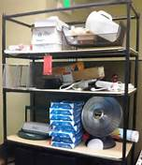
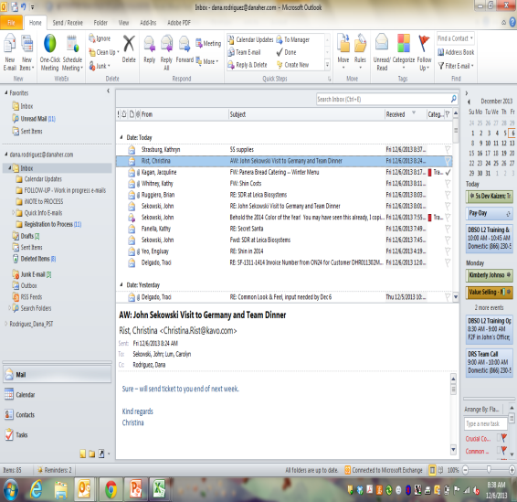
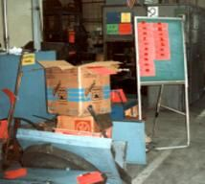
Sort
Determine the necessary and unnecessary
Remove the unnecessary, retain the necessary
WHY | HOW | Examples
Safer work area | Red Tagging Bright red to be very visible Match criteria to scope and guidelines Place red-tag items in holding area Determine SMEs and timing | Office shelf
Have only what’s needed | 4 Questions: What is it for? Why do I have it? How often do I use it? Does anyone else have it? | E-mail
Time Savings Quality Built in |  | Factory
Notes:
DO: Make the following key points.
By simplifying, we make life easier, whether it be getting rid of unneeded items on an office shelf, unnecessary e-mails or boxes on a factory floor. Time spent touching and managing things that should not be there is a great waste of time, money, and effort, and a great cause of frustration
Red tagging is a tracking process to provide visual identification of unneeded items. After all obvious items have been thrown away, remaining items are “red-tagged” to assure proper disposition.

Slide 8
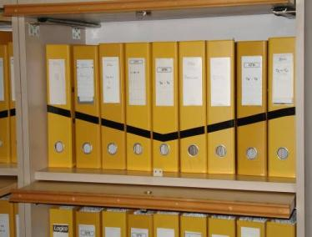
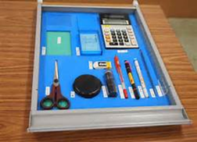
Set In Order
Organize the necessary items so that they can be used and returned to their designated location easily and safely
WHY | HOW | Examples
Makes the job easier for everyone Easy to find things | Decide where all items should be | Organized office manuals using black tape
Easy, safe return | Choose proper storage methods | Shadow box for office supplies
Items available when and where needed | Visually indicate locations
Notes:
DO: Make the following key points.
Setting things in order makes things easier to find, safe and easy to return, and ensures that items are available when you need them.

Slide 9

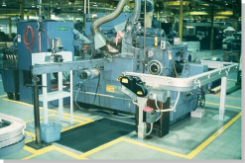
Shine
Cleaning all areas of the workplace
WHY | HOW | Examples
Make the space clean enough to see when something has changed or is at risk of changing | Deep clean or sweep (virtual) Eliminate all trash and clutter
Allows you to take corrective action when there is a change | Assign cleaning responsibilities to different work areas Make cleaning part of everyday work
Notes:
DO: Make the following key points.
Shine - Cleaning all areas of the workplace. Its about fixing so that it doesn’t happen again. Allows you to take corrective action when there is a change.

Slide 10
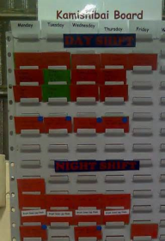
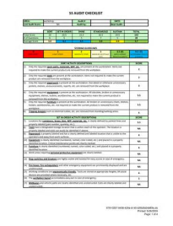
Standarize
PUT SYSTEMS IN PLACE TO ENSURE THE FIRST 3Ss ARE SUSTAINABLE
WHY | HOW | Examples
Ensures sustainment of first 3 Ss | Document the Standard Work Assign accountability Post in work areas
Creates condition for continuous improvement | Create checklist with frequency to maintain the first 3s
Ensures lower risk of quality defects and EH&S issues | Make it easy and visual to adhere to 5S standards
Notes:
DO: Make the following key points.
Now that you’ve shined, its important to ensure that the first 3S are sustainable.

Slide 11
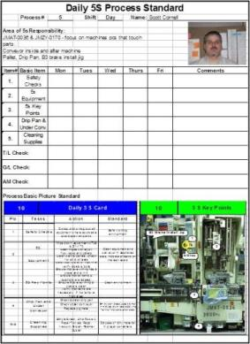
Sustain
Creating the culture (mindset) or habit of sustaining 5S standards
WHY | HOW | Examples
Sustain an organized and clean workspace | Make 5S a personal habit - daily Set a good example everyday Monitor progress, trends and improvements
Promotes improved performance (SQDCI) | Follow 5S Standard Work
Builds a culture of discipline | Set up reminders for scheduled maintenance / audit
Notes:
DO: Make the following key points.
We Sustain so that 6 months from now we have not backslid into the condition we were in before. This is key to continuous improvements and allows for a set up of a system where th new condition or process is a habit.

